Slide 1

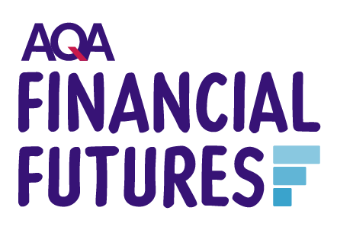

Slide 2
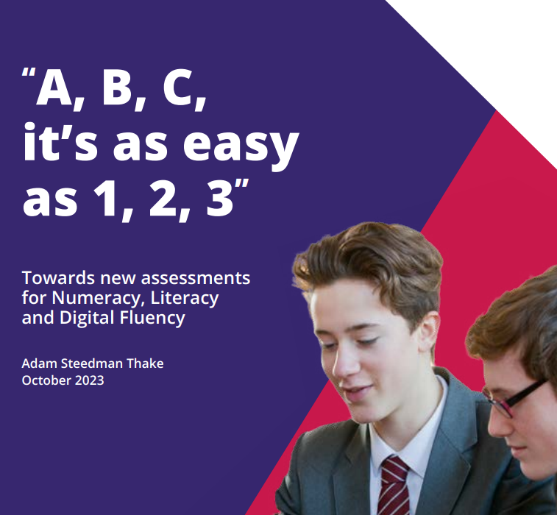
The background and context
Everyone has the potential to achieve numeracy skills which will help to navigate the maths in real life.
For too long, learners have left education unable to solve everyday maths problems.
Policy paper: Towards new assessments for literacy, numeracy and digital fluency
We have a duty to ensure that people are equipped with the skills they need to be fully functioning members of society, and this new style of assessment could help to move us in the right direction."
Notes:
In October 2023, Adam Steedman Thake wrote a policy paper outlining and proposing for change and reform to the current assessment system: Towards new assessments for literacy, numeracy and digital fluency
"A new assessment, aimed at demonstrating numeracy, literacy and digital fluency, taken whenever the learner is ready between 14-19 or even as an adult, de-coupled from high-stakes exams, has the potential to reap huge rewards.

Slide 3
The UK has a financial literacy problem
10 million adults in the UK are financially illiterate
1%
6%
Only
Only
of teachers say that their students possess adequate financial skills
of parents say their children have regular lessons on financial education

Slide 4
Customer Validation
“I had a lot of trauma around it [maths at school] because I didn’t understand the things I’d been told, and I’d keep getting stuff wrong … I didn’t understand, so I just used to get failure, failure, failure.”
Student 1, AP4
“Genuinely, I've never heard anything about taxes, saving, debt, anything in school.”
Student
“I really think this should be essential for all students and nothing like this exists, all in one place. I’d be very interested in this.”
Coordinator, Specialist College
Teacher
“We never got taught these things in school, and a lot of our teachers already struggle with using a more real-life approach to classroom teaching, so it’s definitely not something that everyone is comfortable doing.”
Head of School,
employment-focused college
“The reason we didn't use much of the NatWest and Barclays stuff is because it does dumb it down quite a lot, and students disengage quite quickly if they feel it's been dumbed down.”
​Assistant Headteacher, Sixth form​
Student

Slide 5
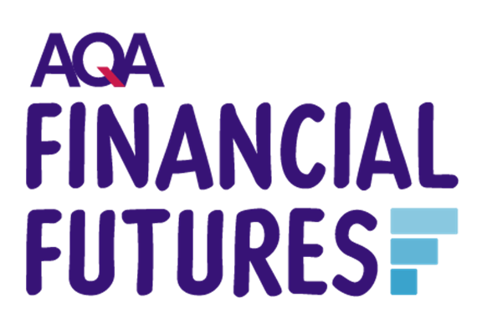
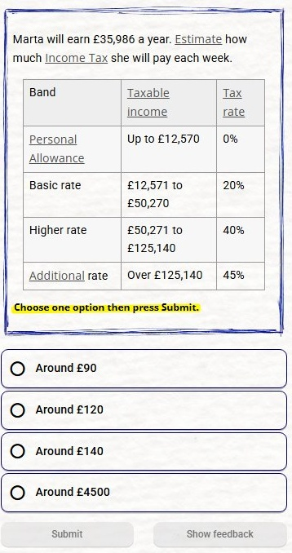

AQA Financial Futures:
Learn it today. Use it for life.
An on-screen tool teaching real life finance management
Developed for and tested by
14–19-year-old learners
Learners receive an assessment and certification after each module
Notes:
Target market but opportunities beyond this
Financial education shouldn’t be complicated, inconsistent, or out of reach. It should be clear, practical, and built for every learner.
AQA Financial Futures is a new approach to financial education – designed to build confidence through understanding, and skills through application.
It gives young people the tools to make sense of money in the real world. Not just to learn it, but to really use it.
Built in bite-sized steps, it fits around real classrooms and real learners. Flexible, structured, and accessible – so every student can progress at a pace that works for them.
Because financial understanding isn’t a bonus skill for some. It’s a life skill for all.
And when learners feel confident with money, they feel more confident about their future.

Slide 6
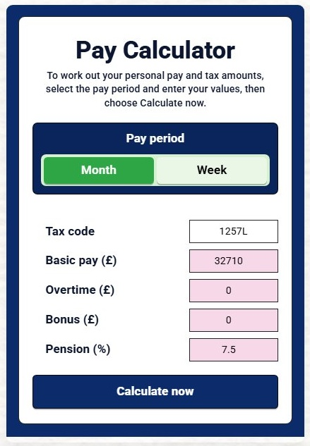
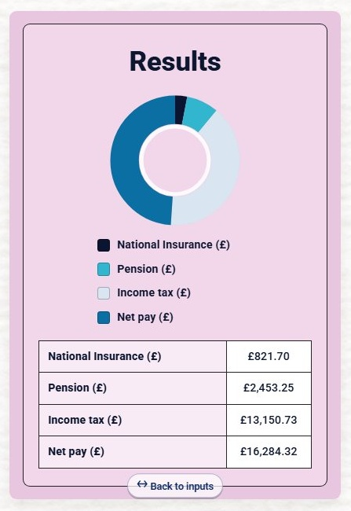
A complete toolkit for teaching real-life money skills
Re-engages learners
Builds confidence
Each student’s pace and pathway
Connects with student priorities
Reduces barriers to learning
Builds practical life skills
Notes:
Real-world approach to numbers​
Estimation​
Risk analysis​
Calculators like learners would find online​
Realistic calculations that they actually need​
Mobile first design allows for homework and off-site use​
Preparing learners for the world of work and the skills they need to negotiate adult life​
Videos explain concepts in clear terms​

Slide 7
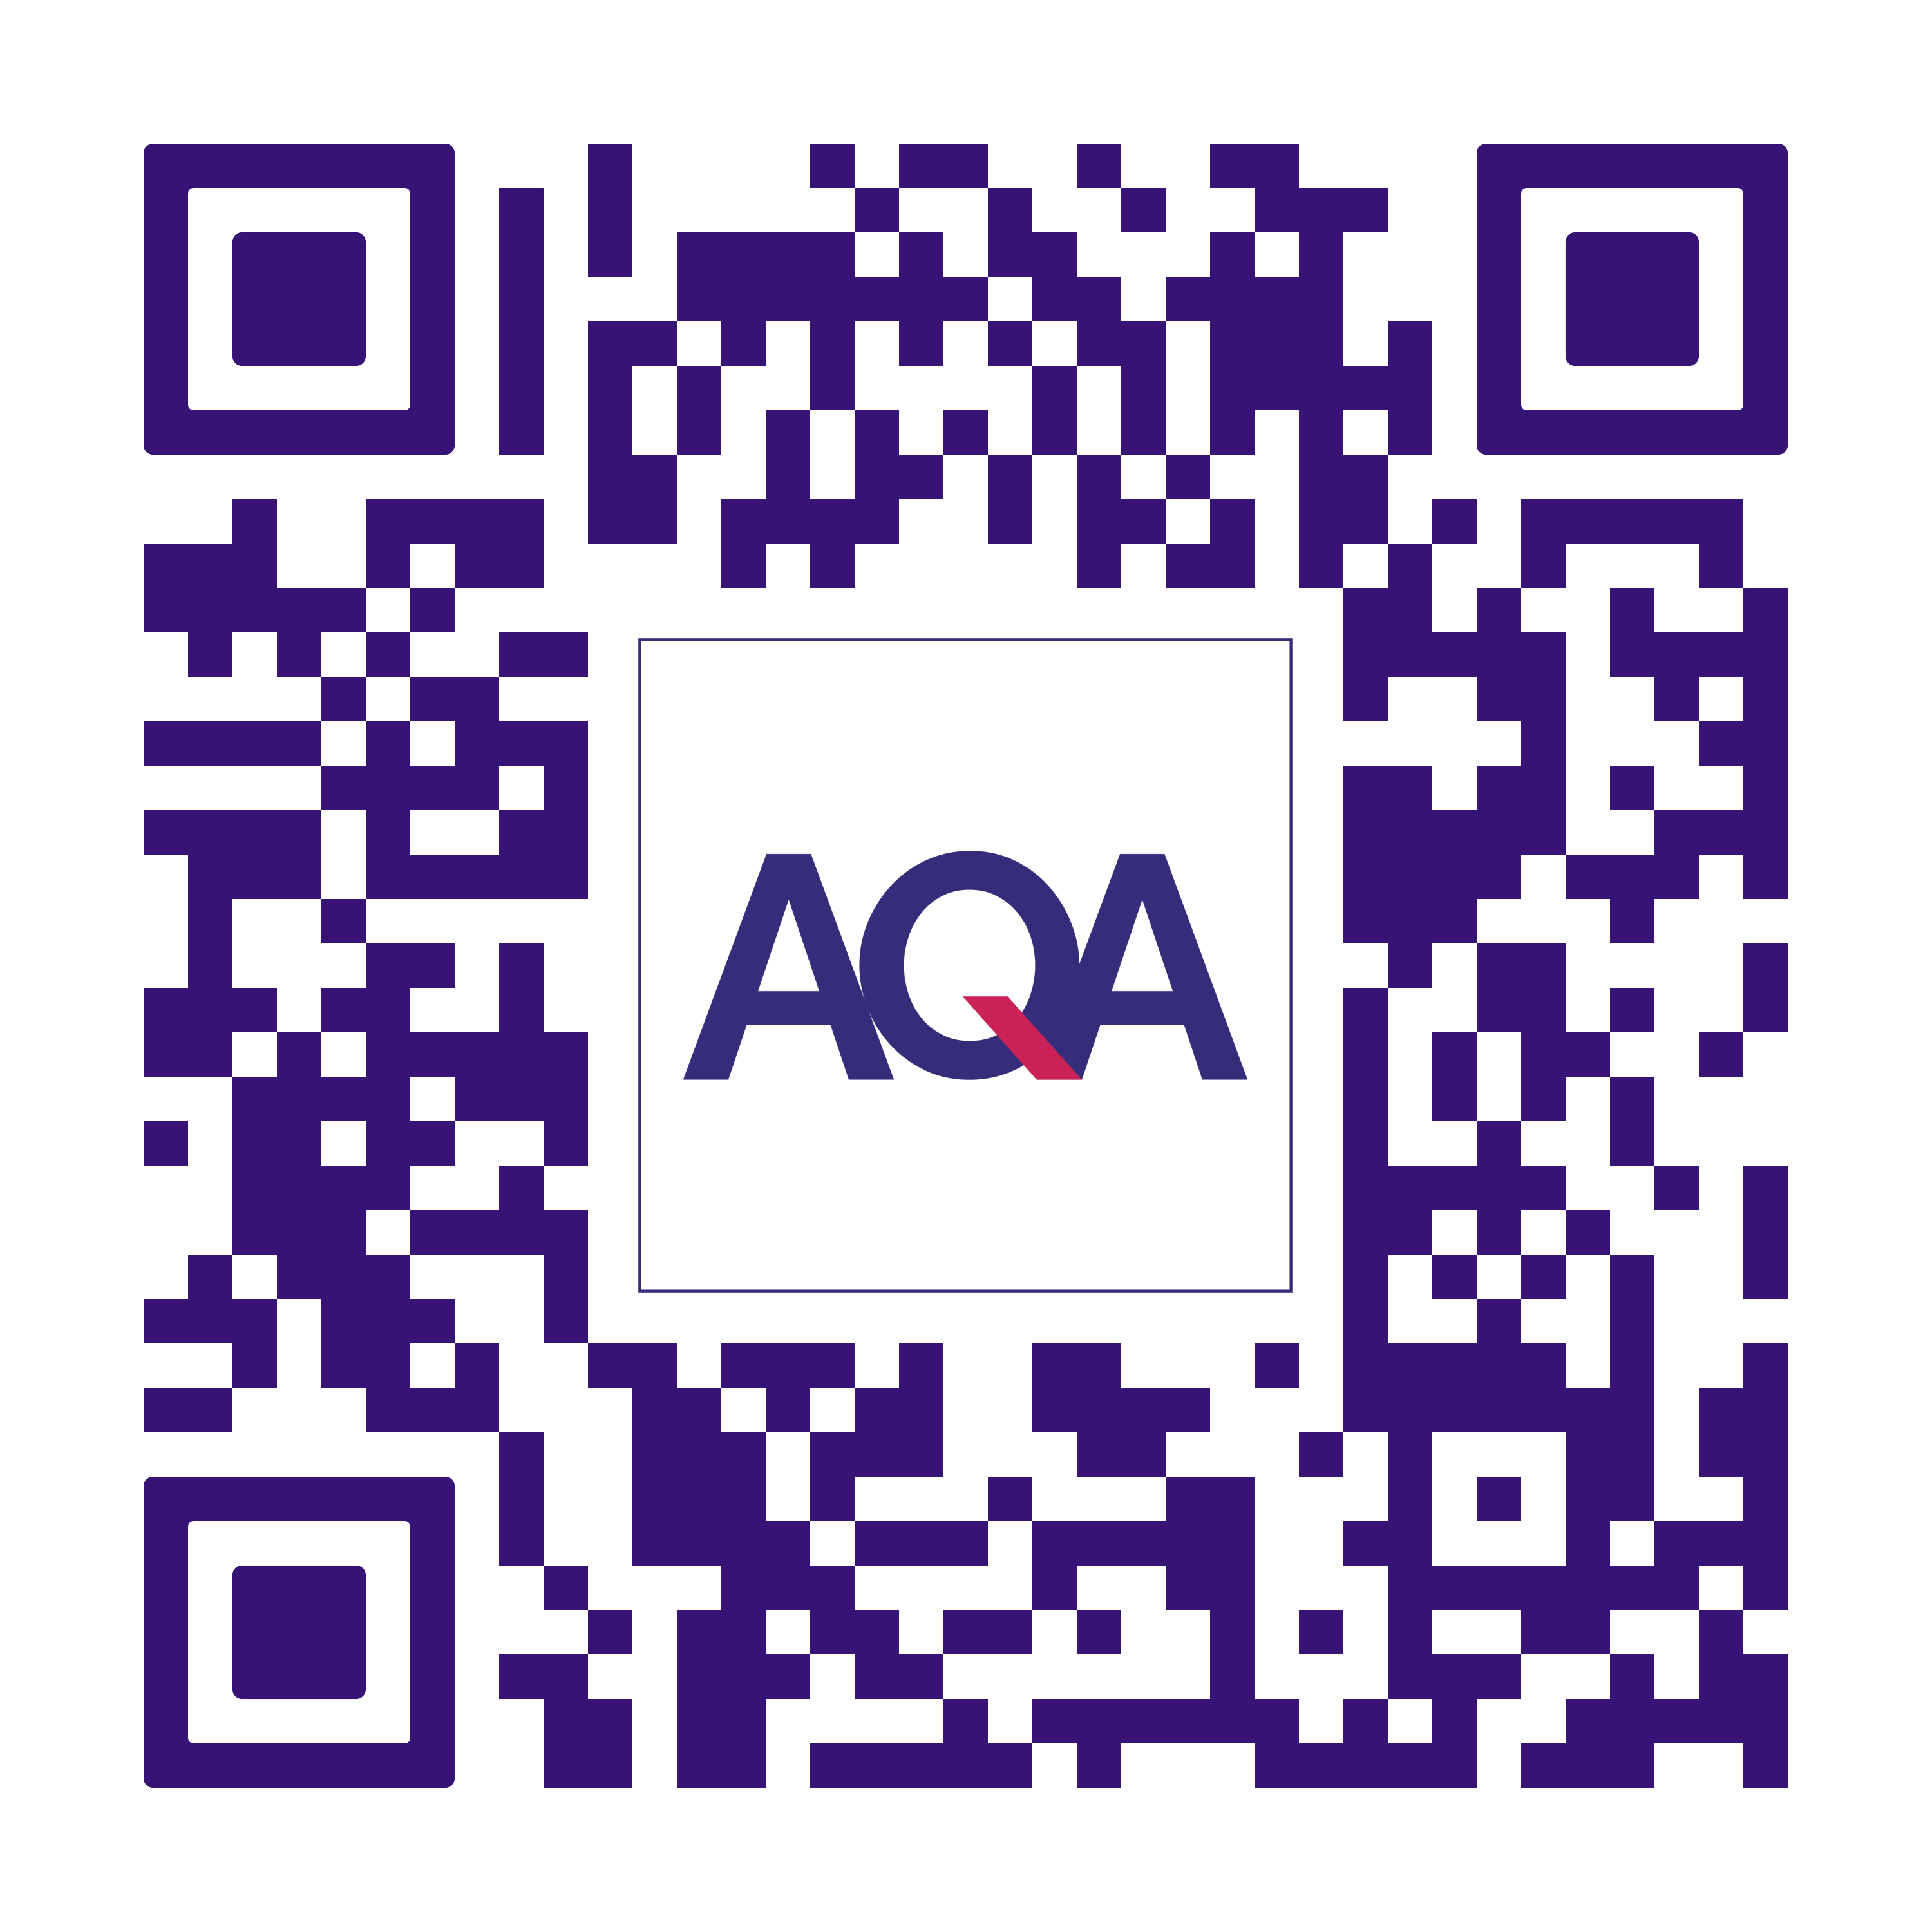
Tackling ‘how’ we fight financial illiteracy
Scan to find out more about Financial Futures
There's nothing else that does the teaching and learning, formative assessment and end assessment to certification.
Fills a known gap – helps address the uneven delivery of financial education.
No additional setup – everything is built into the course and ready to use.
“It helped grow my independence without asking people for help when I'm older.”
Focus Group response
Notes:
Re-engages learners – relevant content that connects with students who may not engage with traditional maths
Bite-sized learning – short, manageable chunks designed to support focus and build understanding
Recognises achievement – AQA certification motivates and provides clear evidence of progress
Connects with student priorities – financial education delivered in a way students find relevant and accessible
Encourages independent learning – students can work at their own pace and pathway
Reduces barriers to learning – clear, structured content supports a range of abilities
Builds confidence with money – supports students who may lack confidence with numbers and finance
Builds practical life skills – applies learning to real-world money and everyday financial decisions

