Slide 1

Sitting your
GCSE Maths exam

Slide 2
Remember, everyone wants you to succeed.

Slide 3
Preparing for your exam

Slide 4
Leading up to the exam
  Space out your revision – don’t expect to be able to do all your revision the night before an exam.
  Know your strengths and weaknesses, and work on your weaknesses.
  Make sure that you get a good night’s sleep – the brain doesn’t work optimally when tired.
The morning of the exam
  Eat breakfast – the brain needs fuel to work.
  Make sure that you get to school in good time for your exam’s start time – there’s nothing worse than stressing (about being late) when going into an exam.
  Do a little last-minute revision – go into the exam having done a little maths and gained confidence.

Slide 5
The non-calculator exam
GCSE Mathematics - Paper 1 Foundation/Higher Tier
Have your standard equipment to hand –
a black pen, a pencil, and a ruler
    The exam is out of 80 marks and lasts 1 hour and 30 minutes
    Answer all questions, writing down your full workings for each question
    Answer the questions in the spaces provided, not in blank spaces, and not outside the box around each page
    If you need extra space, write the question number on the lined paper at the end of your exam paper and complete your work there
    Do all rough work in your exam paper, crossing through any work which you don’t want to be marked
You may need a protractor, a pair of compasses, and tracing paper
You must not use a calculator

Slide 6
The calculator exams
GCSE Mathematics - Paper 2 and Paper 3 Foundation/Higher Tier
    Have your standard equipment to hand –
    a black pen, a pencil, and a ruler
    The exam is out of 80 marks and lasts 1 hour and 30 minutes
    Answer all questions, writing down your full workings for each question
    Answer the questions in the spaces provided, not in blank spaces, and not outside the box around each page
    If you need extra space, write the question number on the lined paper at the end of your exam paper and complete your work there
    Do all rough work in your exam paper, crossing through any work which you don’t want to be marked
You may need a protractor, a pair of compasses, and tracing paper
    You should use a calculator and write down your full workings whenever you do

Slide 7
Formulae sheets

Slide 8
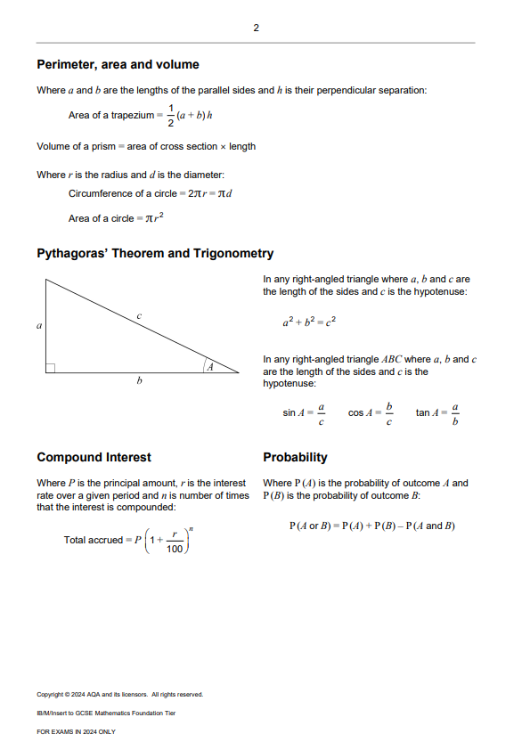
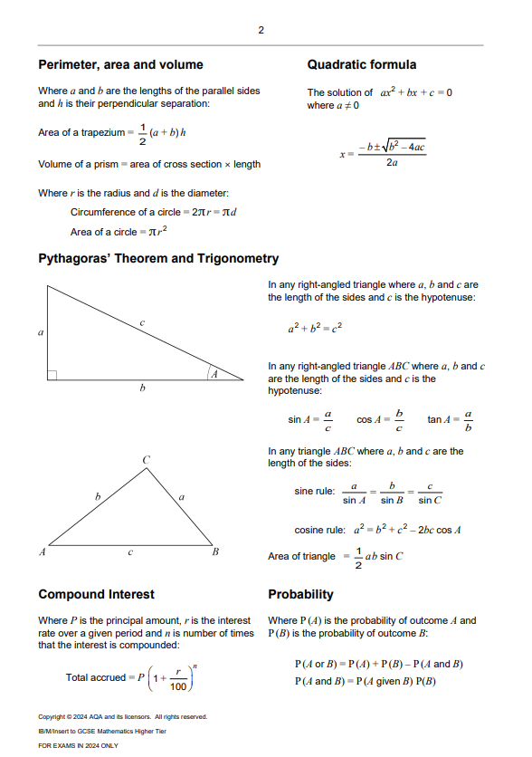
Formulae sheets
    For this year’s exams a formulae sheet will be provided.
    Make sure that you check the insert for useful
    formulae which might help you to answer questions.

Slide 9


Additional formulae
  These formulae are provided within a question where it’s required to answer the question:
  Curved surface area of a cone = $π×r×l$,
  where $r$ is the radius and $l$ is the slant height
  Volume of a cone = $\frac{1}{3}×π×r^{2}×h$,
  where $r$ is the radius and $h$ is the perpendicular height
  Volume of a pyramid = $\frac{1}{3}×area of base×h$,
  where $h$ is the perpendicular height
  Surface area of a sphere = $4×π×r^{2}$,
  where $r$ is the radius
  Volume of a sphere = $\frac{4}{3}×π×r^{3}$,
  where $r$ is the radius
  Final velocity: $v=u+a×t$, $v^{2}=u^{2}+2×a×s$
  Displacement: $s=u×t+\frac{1}{2}×a×t^{2}$,
  where $a$ is constant acceleration, $u$ is initial velocity, $v$ is final velocity, $s$ is displacement, and $t$ is time.

Slide 10


Additional formulae
  These formulae aren’t provided within an exam paper, and it’s expected that you know them:
  Area of a rectangle = $l×w$,
  where $l$ is the length and $w$ is the width
  Area of a triangle = $\frac{1}{2}×b×h$,
  where $b$ is the base and $h$ is the perpendicular height
  Area of a parallelogram = $b×h$,
  where $b$ is the base and $h$ is the perpendicular height
  Volume of a cuboid = $l×w×h$,
  where $l$ is the length, $w$ is the width and $h$ is the height
  Volume of a prism = $area of cross section×l$,
  where $l$ is the length
  Volume of a cylinder = $π×r^{2}×h$,
  where $r$ is the radius and $h$ is the height
  Speed = $distance÷time$
  Density = $mass÷volume$
  General form for the equation of a straight line: $y=mx+c$,
  where $m$ is the gradient, $c$ is the $y$-intercept
  General form for the equation of a circle (Higher tier only):
  $x^{2}+y^{2}=r^{2}$, where $r$ is the radius.

Slide 11

Hints and tips

Slide 12

How to approach worded problems
Read the question
Identify key information
Recall any relevant formulae
  Understanding the question and what is being asked before writing any working.
  Perhaps by underlining key words or information. Give attention to differing units, as these might need converting.
  That you might need to apply within the question.
Start at the beginning
Write the units in your calculations
Review your work
  Begin thinking about how the numbers interact with each other
  and write down the required calculations.
  Avoid confusion about what different numbers represent, possibly adding notes to your work to avoid any confusion.
  Make sure that your answers make sense in the context offered, and that you have answered all parts of the question. It’s easy to forget the goal in multi-step problems.

Slide 13
Tips for during the exam
Read the question
Show your working
Attempt every question
  Take your time to read the question carefully
  Identify key terms to direct your working.
  Write down all the steps in your work, including work you used a calculator for.
  Marks can be awarded for correct methods, even if you don’t get to the correct answer.
  Write down what you know, even if you don’t get the final answer.
  An educated guess is better than leaving a question blank.
Use time wisely
Take care with writing
Check your work
  Each mark roughly equates to 1 minute. Aim to spend about 2 minutes on questions worth 2 marks.
  Use ‘banked’ time to work through harder questions.
  Make sure that your workings and answers are clear. Only cross out work that you don’t want to be marked when it has been replaced with new work.
  Make sure that you have answered the question being asked, and that your answer makes sense in context.

Slide 14
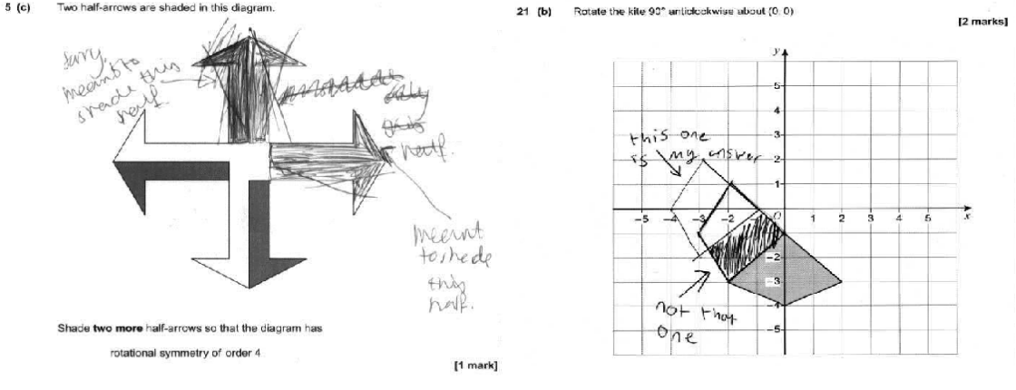
Insights from the examiners
Present your work clearly –
‘scruffy’ work is a common cause of lost marks. Draw diagrams in pencil, so you can erase your work if needed

Slide 15
Insights from the examiners
  Check your work often –
  Basic calculation errors are common, and you wouldn’t normally make them
  Use a calculator when you can –
  Marks are often lost through inaccurate calculations in papers 2 and 3
  Use the formulae sheet –
  Incorrectly recalling a provided formula will result in marks being lost
  Begin questions by writing down what you can –
  Longer questions tend to result in more ‘non-attempts’, but you could gain some marks by writing down what you know about the question.

Slide 16

Fake exam papers
Papers advertised online are almost always fake and there are serious penalties for engaging with these accounts.

Slide 17

Every question matters,
take your time,
do your best.

Slide 18
Copyright © 2024 AQA and its licensors. All rights reserved.

